Slide 1
How will you take care of your research data?
Learn what’s required
Funding body and University requirements
Security for sensitive data
GDPR and personal data
Learn what’s required
Find out what’s available
University services for keeping data safe
Tools and technologies
Support and training
Find out what’s available
… and for the future
Plan for your project…
Build a data management plan
Put good processes in place early on
… and for the future
Discover options for long-term data preservation
Facilitate data sharing and reuse
Plan for your project…
Notes:
This presentation is designed for use in induction sessions, or anywhere where a brief introduction to research data management is needed. It uses animations to reveal information gradually: view in slideshow mode to see everything.
Taking good care of your research data is an integral part of doing good research. This slide lists a few key areas to think about.
Learn what’s required
Your funding body and the University may ask you to meet certain requirements regarding research data. There are also legal and ethical requirements around the handling of data about identifiable individuals, or data which is sensitive for other reasons.
Find out what’s available
There are plenty of resources available to help you take care of your data, including University services for storing and managing it, and software tools and technologies for structuring and analysing it. You can also access personalised support and guidance, along with training.
Plan for your project…
A good data management plan helps a project run smoothly. Putting solid processes in place early on in the research process will help make life easier, saving time and avoiding potential problems later.
… and for the future
You should also think about what will happen to your data beyond the end of your project. Data is a valuable resource, so it’s worth looking at options for long-term preservation, and considering whether all or part of it can be shared or made available for reuse by other researchers.
[Images on this slide created by the Research Data Oxford team, using Microsoft’s icons: used with permission from Microsoft.]
This slideshow was prepared by the Research Data Oxford team, and is made available under the Creative Commons Attribution Non-Commercial License: https://creativecommons.org/licenses/by-nc/4.0/. Subject to the terms of the license, you are welcome to reuse or adapt this material for your own purposes. Last updated in September 2023.]

Slide 2
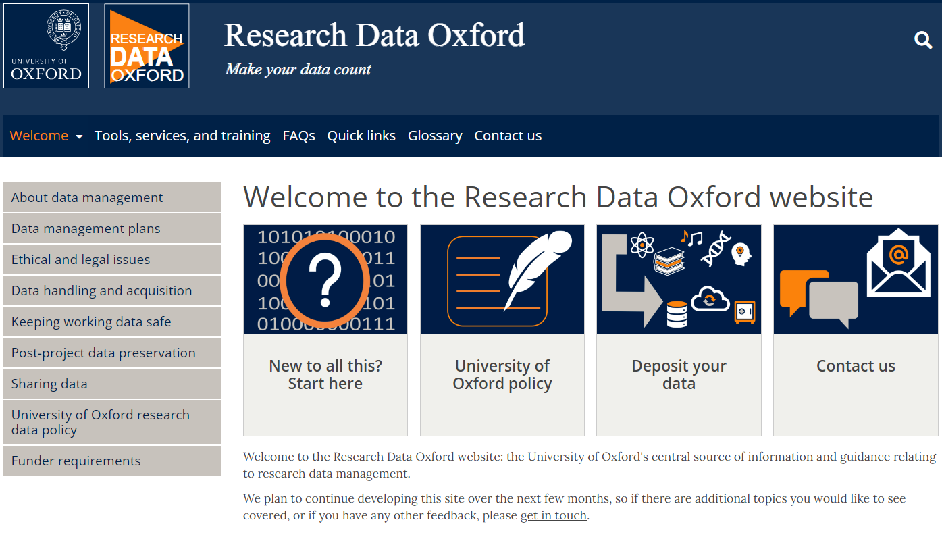
Research Data Oxford can help
Visit the website
Guidance and resources
https://researchdata.ox.ac.uk
Contact the team
Personalised support
researchdata@ox.ac.uk
Notes:
Help with all the areas listed on the previous slide (and more) is available from Research Data Oxford. Visit the website (https://researchdata.ox.ac.uk/) for guidance and information about helpful resources. You can also contact the Research Data Oxford team for personalised advice and support – email researchdata@ox.ac.uk.

